Slide 1
What might be the approach for mapping between different models of DSpace and VIVO (elements, concepts, fields)?
Three different approaches:
Using the Dspace RDFizer
Build a VIVO exporter from Dspace Postgres database
Build a VIVO exporter from DSpace REST-api
Notes:
Data mapping between de VIVO and DSpace is a process that can be performed in multiple ways. Here we present three approaches that can be considered for this task
1

Slide 2
ETL Metamodel
Source DataBase
Source Data
Target Data
Target DataBase
1)
2)
3)
Extract
Transform
Load

Slide 3
First approach: using the Dspace RDFizer Ref: https://wiki.lyrasis.org/display/DSDOC7x/Linked+%28Open%29+Data
DSpace data
DSpace Data
RDFized DSpace data in RDF
RDFize
Translate DSpace data to VIVO perspective
metadata-rdf-mapping
Using Dspace rdfizer exporter
DSpace semantic
VIVO perspective of DSpace Data
DSpace-to-vivo-sparql-construct query
metadata-rdf-schema
VIVO semantic
VIVO ontology
Notes:
The first approach is to use the RDFIzer which is currently provided by Dspace
The transformation process we propose, which has been tested several times consists of:
first, translating the DSpace source data into an RDF graph representation. This task to be performed by the DSpace RDFizer
Second, translate into VIVO perspective the DSpace source data within an RDF format using a SPARQL construct query
The SPARQL query uses the following files as input :
DSpace source data in RDF format
the files representing the DSpace data semantics which are in RDF
the VIVO ontology used to contextualize the data sources in the VIVO perspective
3

Slide 4
Second approach: Build a VIVO exporter
1) RDFize DSpace semantics
2) RDFize DSpace data
Note: a third approach can be considered by replacing database access with DSpace API-Rest calls
VIVO semantic
VIVO Ontology
Using classical JDBC Drive
DSpace semantic
DSpace REST-Api
1)
DSpace Postgres DataBase
XML/CSV
DSpace schema
RDF
DSpace schema Vocabulary
3)
DSpace data in the VIVO perspective
Export DB schema
Xml2json + json2rdf
RDF DSpace Data mapping to VIVO
2)
XML/CSV
DSpace data
Xml2json + json2rdf
RDF
DSpace data
Export DB data
DSpace data
Notes:
This approach consists in producing a VIVO representation of DSpace data from a source data extraction mechanism directly from the Postgres database used by DSpace.
The block 1 presents the semantization process of the Dspace data structure. The process consists in extracting the database schema and storing it in an XML or CSV file. The translation of this XML file into RDF is produced by the XML2JSON and JSON2RDF utilities. The result of this process is an RDF ontology representing the structure of the source database tables. This process does not involve any particular risk since we have implemented this type of processing in many of our projects.
Block 2 which has been processed similarly to block one is mainly oriented to extract the data contained in the database. The result is therefore a graph of data in RDF format that are structured in the Dspace perspective.
Finally, block 3 consists in performing a mapping between the semantized data from the Dspace perspective to a semantized data from the VIVO perspective. As for the previous approach, this mapping is performed by a SPARQL construct query.
The process of the third approach is similar to the second approach except that the data source comes from the Dspace REST-API instead of from the Postgres database.
4

Slide 5
Third approach: Build a VIVO exporter
OpenApi DspaceData Metamodel (YAML)
Jave DSpace Model Library
Swagger generator
DSpace REST-Api
1)
DSpace Postgres DataBase
2)
DSpace exporter
JSON Dspace Data
RDF DSpace Data mapping to VIVO
DSpace data in the VIVO perspective
VIVO Ontology
Notes:
This approach consists in producing a VIVO representation of DSpace data from a source data extraction mechanism directly from the Postgres database used by DSpace.
The block 1 presents the semantization process of the Dspace data structure. The process consists in extracting the database schema and storing it in an XML or CSV file. The translation of this XML file into RDF is produced by the XML2JSON and JSON2RDF utilities. The result of this process is an RDF ontology representing the structure of the source database tables. This process does not involve any particular risk since we have implemented this type of processing in many of our projects.
Block 2 which has been processed similarly to block one is mainly oriented to extract the data contained in the database. The result is therefore a graph of data in RDF format that are structured in the Dspace perspective.
Finally, block 3 consists in performing a mapping between the semantized data from the Dspace perspective to a semantized data from the VIVO perspective. As for the previous approach, this mapping is performed by a SPARQL construct query.
The process of the third approach is similar to the second approach except that the data source comes from the Dspace REST-API instead of from the Postgres database.
5

Slide 6
What about vocabularies (different list of scientific fields for instance) ?
Notes:
6

Slide 7
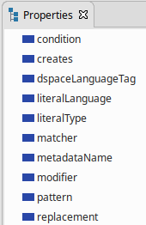
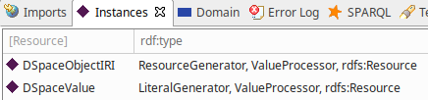
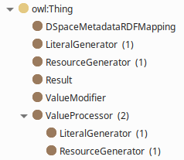
Data structure from the RDFizer usage
Mapping semantic
metadata-rdf-schema.ttl
Describe
Data semantic
metadata-rdf-mapping.ttl
Data structure for the "create a title" action
Action name
:title
dm:creates [
dm:object dm:DSpaceValue ;
dm:predicate dcterms:title ;
dm:subject dm:DSpaceObjectIRI ;
] ;
dm:metadataName "dc.title" .
Action parameter (using Reification)
Target predicate
Notes:
In this slide we will focus on the data structure that is produced by the Dspace RDFizer
Files are provided with the Dspace RDFIzer. These two ontologies represent the data semantics that are provided when the RDFIzer extracts data from Dspace.
These three panels are a visual representation of the Dspace metadata ontologies content as presented in VIVO-Studio. It shows the property structure, the class structure and the individuals contained in these ontologies.
For example, here is the data structure for the "create a title" action
First of all the definition of the action in this case "create".
Secondly, the definition of the target predicate associated with the action
And finally the command reification that will be injected in the target ontology
7

Slide 8
Example of data conversion from Dspace RDFized data to VIVO data
:some_title
rdf:type rdf-mapping:title ;
rdf:type owl:NamedIndividual ;
dm:creates [
rdf:type dm:Result ;
dm:object [
rdf:value " The DSpace Course - An Introduction to DSpace " ;
rdfs:type dm:DSpaceValue ;
] ;
dm:predicate dcterms:title ;
dm:subject [
rdf:type dm:DSpaceObjectIRI ;
rdf:value "http://doi.org/1234" ;
] ;
] ;
dm:metadataName "dc.title" .
vivo-uqam-data:n2138
rdf:type obo:BFO_0000001,
rdf:type obo:BFO_0000002 ;
rdf:type obo:BFO_0000031 ;
rdf:type obo:IAO_0000030 ;
rdf:type bibo:BookSection ;
rdf:type bibo:Chapter ;
rdf:type bibo:Document ;
rdf:type bibo:DocumentPart ;
rdf:type owl:Thing ;
bibo:abstract "This module …"@en-US ;
bibo:doi "http://dio.org/1234";
vitro:mostSpecificType bibo:Chapter ;
vivo:dateTimeValue vivo-uqam-data:n5481 ;
vivo:relatedBy vivo-uqam-data:n7404 ;
vivo:relatedBy vivo-uqam-data:n887 ;
rdfs:label "The DSpace Course - An Introduction to DSpace"@en-US ;
.
Mapping to do by the SPARQL Construct
Notes:
This slide presents an example of the DSpace RDFizer data mapping to the VIVO perspective. This is a type of processing that could be performed by the SPARQL construct.
First the predicate contained in the action reification is interpreted as a VIVO document.
Secondly the title value is translated in the VIVO ontology into an RDFS:label
Finally the subject which is a DOI is encoded in bibo:doi of the VIVO entity.
8

Slide 9
How do you think data should be kept up to date after initial migration of data from DSpace to VIVO? How should the software communication between VIVO and DSpace be implemented?
Three architectures to answer these two questions
Architectural solution 1 : DSpace/VIVO facade
Architectural solution 2 : Add semantic web functionality to Dspace
Architectural solution 3 : Messaging patterns
Notes:
To answer these questions we will present three solutions:
1- VIVO's Dspace facade,
2- the addition of semantic functionality to Dspace, and
3- the use of the messaging pattern to ensure communication between de VIVO and Dspace.
9

Slide 10
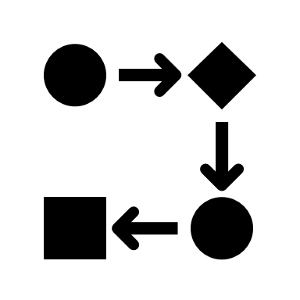



Architectural solution 1 : DSpace/VIVO facade A single, standardized access point between VIVO and Dspace.
Facade is a structural design pattern that provides an interface for easy access to a library, framework or any complex set of classes.
RDFizer is an on-demand translator of DSpace data into a set of RDF triples that are stored in a triplestore accessible through a SPARQL endpoint.
The DSpace/VIVO facade is accessible to a web client and provides a single-entry point that unifies communications between the various components of the ecosystem
The SPARQL federated search allows to unify the result of a search even though it is distributed over the two data sources Fuseki and VIVO
DSpace
DSpace/VIVO Facade
HTTP: REST
Web Client
RDFizer
Apache Jena/Fuseki
SPARQL Query
HTTP Rest
SPARQL Query
VIVO
SPARQL Update
DSpace/LOD Document: https://wiki.lyrasis.org/display/DSDOC7x/Linked+%28Open%29+Data
Notes:
This slide presents the main components of the solution allowing communication and data exchange between VIVO and Dspace in order to make them accessible to a web client. The solution offers a standardized interface and a single access point to a web client that will manage the communication between Dspace and vivo
Facade is a structural design pattern that provides an interface for easy access to a library, framework or any complex set of classes.
RDFizer is an on-demand translator of DSpace data into a set of RDF triples that are stored in a triplestore accessible through a SPARQL endpoint.
The DSpace/VIVO facade is accessible to a web client and provides a single-entry point that unifies communications between the various components of the ecosystem
The SPARQL federated search allows to unify the result of a search even though it is distributed over the two data sources Fuseki and VIVO
The data synchronization periodicity is delegated to an external service of the facade which is in fact a kind of Web client
10

Slide 11
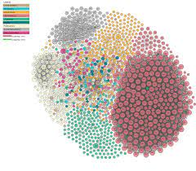
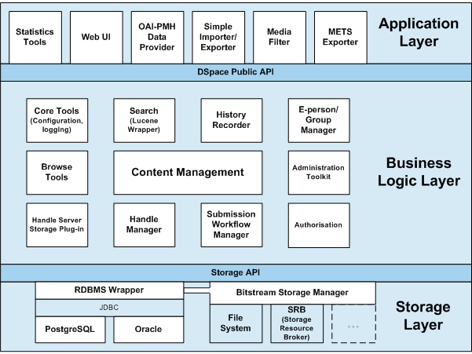
Architectural solution 2 : Add semantic web functionality to DSpace
Extend the storage layer by adding an RDF triplet database (TDB) whose contents are synchronized in real time with the system's metadatabase
Add a SPARQL query editor and SPARQL endpoint Api to the application layer
Data synchronization between VIVO and DSpace is ensured by the facade through the SPARQL protocol
LOD
DSpace technological architecture
SPARQL Query Editor
SPARQL Query
SPARQL endPoint API
DSpace/VIVO Facade
SPARQL Update
Jena TDB
SPARQL Query
VIVO
SPARQL Update
Notes:
The second solution consists in modifying the Dspace architecture to include Semantic Web functionalities. The communication between de VIVO and Dspace is always provided by a façade
Here are the details of this architectural model
Extend the storage layer by adding an RDF triplet database (TDB) whose contents are synchronized in real time with the system's metadatabase
Add a SPARQL query editor and SPARQL endpoint Api to the application layer
Data synchronization between VIVO and DSpace is ensured by the facade through the SPARQL protocol
The DSpace semantic instance can thus become a LOD node
11

Slide 12
Architectural solution 3 : Messaging patterns
The main objective of the Message Design Pattern is to decouple the software from its external interfaces.
This pattern allows iterative interface development while maintaining backward compatibility.
The message is an exchange of information between a sender and one or many receivers. The message management is provided by the messaging system
In the message flow example, DSpace is the sender of the message and the receivers are VIVO and the other sources that are connected to the Messaging system.
Data from different sources are synchronized in real time
The DSpace/VIVO facade allows federated search execution using SPARQL query
Data can also be accessed by a client directly from the messaging system
The current VIVO-DataConnect project uses this pattern. It is specially designed to standardize the integration of external data sources such as Orchid
Messaging System
DSpace
Messages
VIVO
Messages
Other data sources
Messages
DSpace/VIVO DataClient
RDF Data
DSpace/VIVO federated search engine API
Messages
ORCID
Messages
RDF Data
See https://doi.org/10.13140/RG.2.2.22501.83681 for more details on the VIVO-DataConnect project
Notes:
This solution aims to delegate the data exchange control mechanism to a centralized system that manages communications by receiving and sending messages that can contain either commands or data.
By decentralizing the data sources and making them all equivalent to each other this type of solution offers highly scalable, adaptive, incremental characteristics.
For this solution we use the message design pattern.
The main objective of the Message Design Pattern is to decouple the software from its external interfaces.
This pattern allows iterative interface development while maintaining backward compatibility.
The message is an exchange of information between a sender and one or many receivers. The message management is provided by the messaging system
In the message flow example, Dspace is the sender of the message and the receivers are VIVO and the other sources that are connected to the Messaging system.
Data from different sources are synchronized in real time.
The DSpace/VIVO facade allows federated search execution using SPARQL query
Data can also be accessed by a client directly from the messaging system
The current VIVO-DataConnect project uses this pattern. It is specially designed to standardize the integration of external data sources such as Orchid
12

Slide 13
Architectural proposition 4 DSpace Data Mediator
Generic solution for any FrontEnd Mediator based on a messaging system
Specific solution for VIVO as a FrontEnd Mediator based on a data synchronisation system
Other Web-API eg. ORCID
VIVO
Dspace Front-end
VIVO
Dspace Front-end
VIVO TripleStore (SPARQL endPoint)
VIVO TripleStore (SPARQL endPoint)
Owner API
DSpace Data-Connect Mediator
DSpace Data-Connect Mediator
DSpace Back-End REST-api
DSpace Back-End REST-api
Dspace Back-end
Dspace Back-end

Slide 14
In summary: Architecture comparison table
Description | Architecture 1 Facade pattern | Architecture 2 Merge SW functions | Architecture 3 Messaging pattern
development + testing + deployment aspect Estimated effort in number of sprint (3 weeks) | ~5 sprints | ~8 sprints | ~12 sprints
Maintenance aspect | More complex due to the dependency between applications | Improved by removing a component (RDFizer & Fuseki) of the architecture | Simplified by the complete decoupling of the software components
Main advantage | Easy to develop, implement and debug | Enables metadata interoperability and allows Dspace to become an LOD node + providing direct access to a SPARQL endpoint | Scalable and adaptive data management architecture
Main disadvantage | Tight coupling between components | Requires a major revision of the DSpace architecture | Development and implementation complexity
Notes:
This table aims to make a summary comparison between the three architectures
14

